Slide 1
What is HbbTv?

Slide 2
HbbTV is What?
Hybrid Broadcast and Broadband Television
Standards Body
Standard Itself
Rules for integration of data “streams”

Slide 3
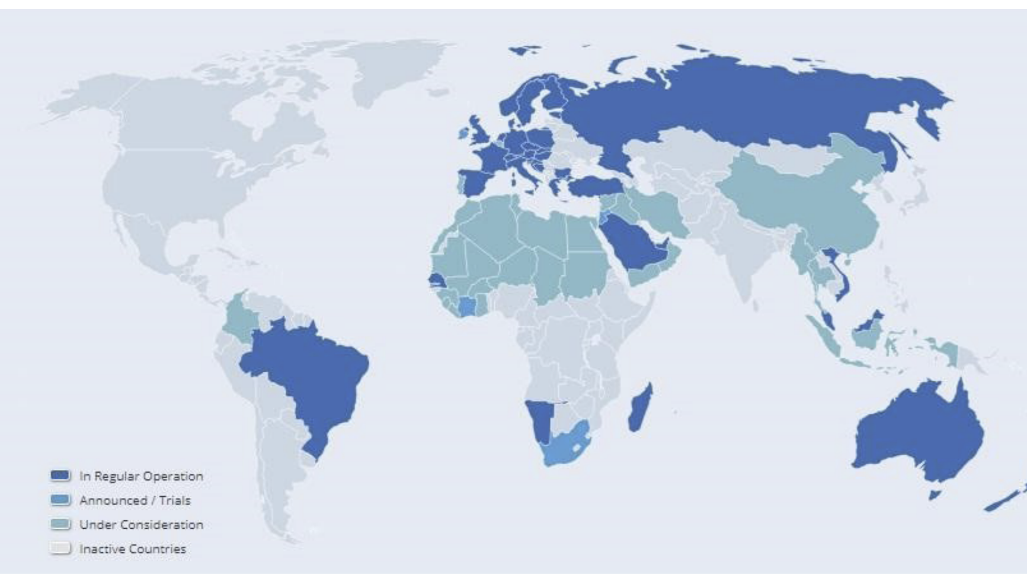
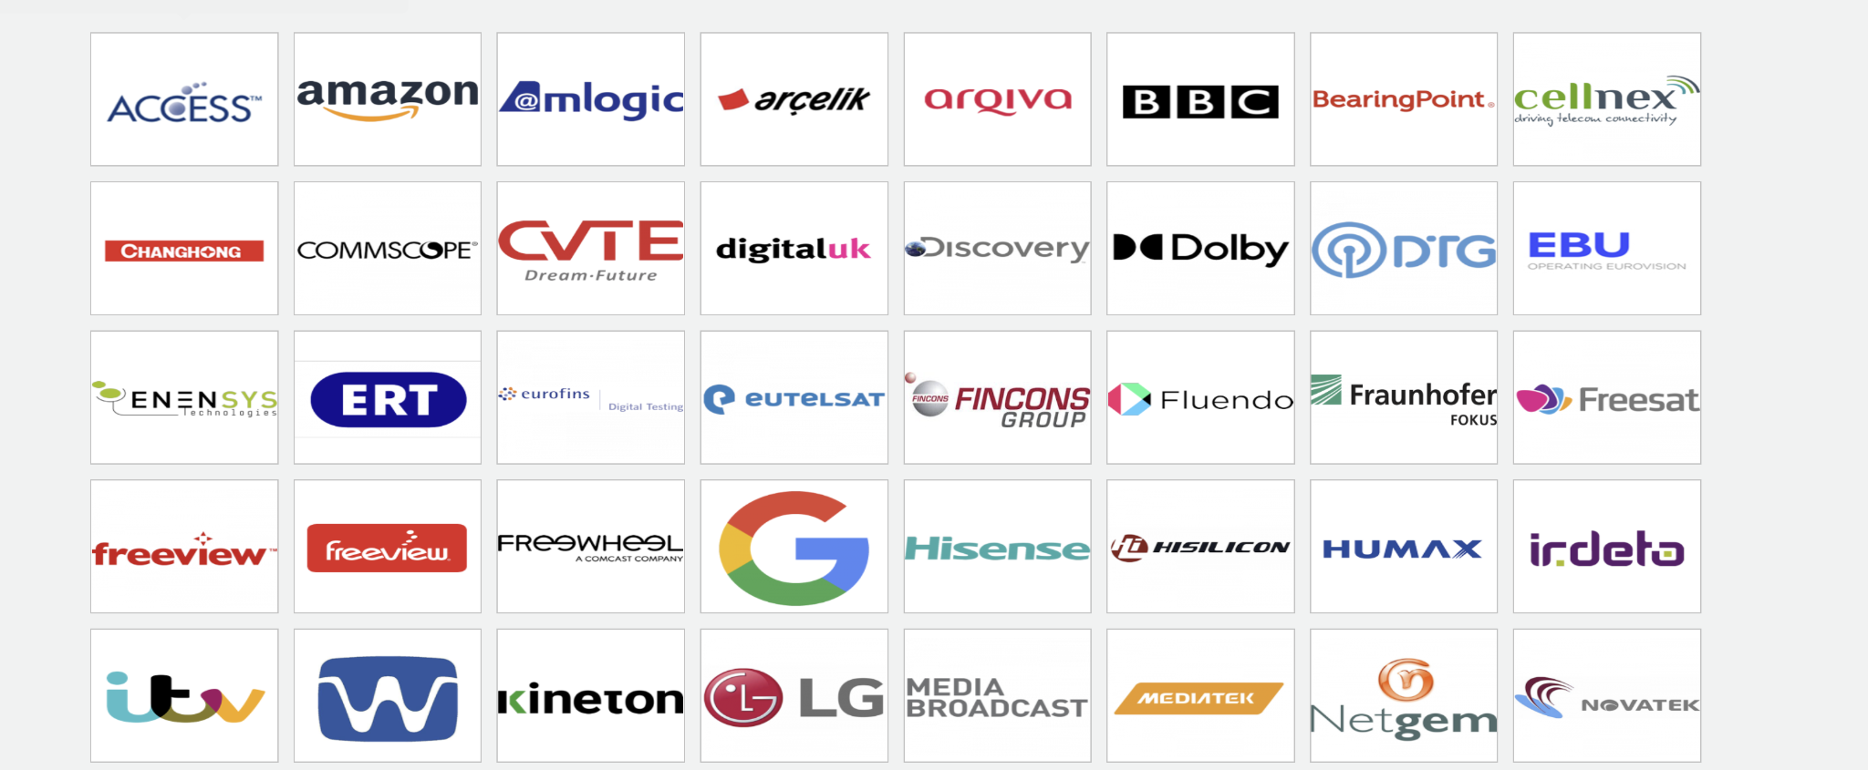
Who is involved?

Slide 4





Standards Inside HbbTV

Slide 5
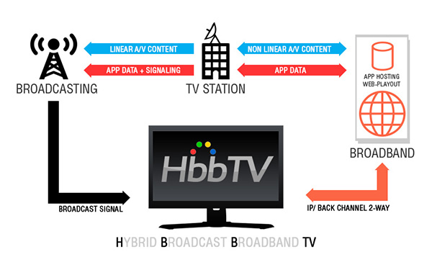
What the broadcast signal is used for
Within the Broadcast signal there are the normal contents of the signal such as audio and video
There is also extra data within the signal such as the PID (Programme ID) the broadcaster ID
Also layered within the signal there are many different flags to be used by HBBTV
Notes:
List the data types
Whats embedded in the signal

Slide 6
What the IP/Broadband Connection issued for
The Internet connection is used to collect many different types of data
This can simple webpage or gifs or lookups in databases
It is down to the broadcaster to decide what they want the HBBTV device to look for
This can be triggered by the user or automatically by the broadcast data streamed
Notes:
What types of data
Who holds the data
How it’s going to function

Slide 7
How the Broadcast Signal and IP work together
To work together both the internet and broadcast signal use a timer to sync which is started from when the broadcast starts
If the box is capable it will also buffer a certain amount of the broadcast or stream so it can be more easily synced
The flags mentioned earlier can be used to make the app fetch data and integrate it on the screen
To be able to carry out these tasks the HBBTV box has the ability to decode multiple streams of information at once
An example is a reminder to press the red button
Notes:
How the timer synchronises from the main media stream
How the multimedia decoder

Slide 8
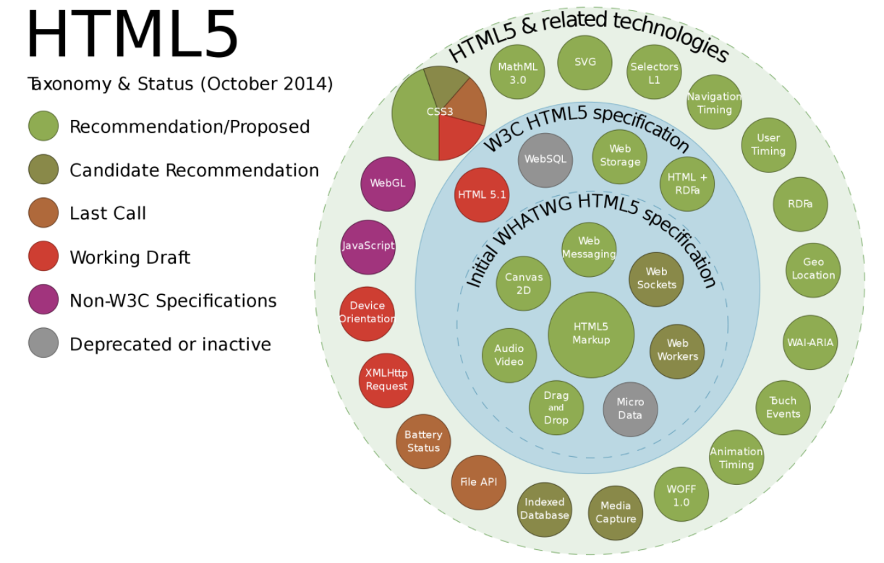
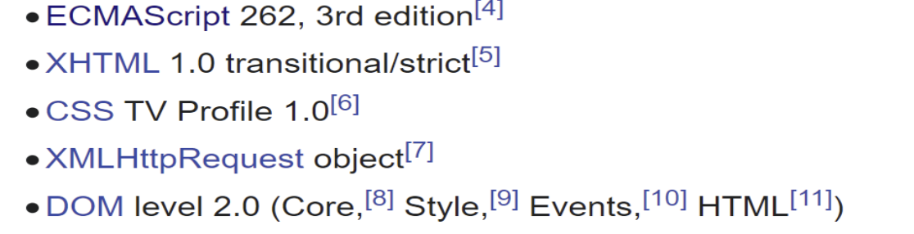

Usage of Javascript/ HTML/ CSS
Mozilla/5.0 (Linux; Tizen 2.3; SmartHub; SMART-TV; SmartTV; U; Maple2012) AppleWebKit/538.1+ (KHTML, like Gecko) TV Safari/538.1+
Samgsung Smart TV

Slide 9
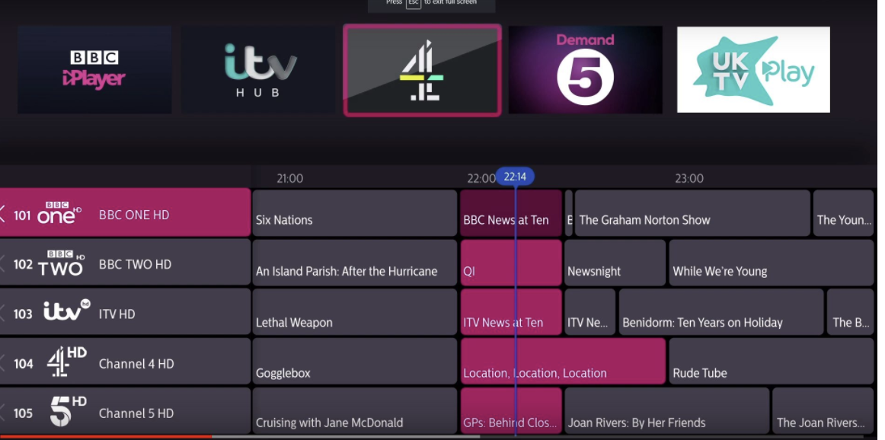
Example : How the EPG Works and uses both technologies

